Slide 1
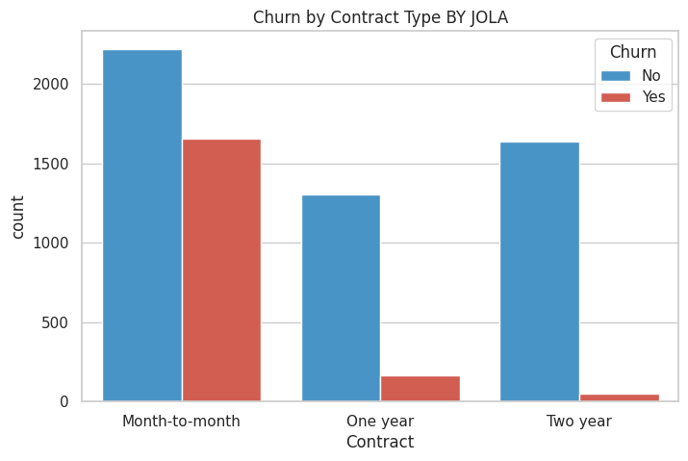
Analyst lab Internship
WHY PATIENTS MISS APPOINTMENTS
AND WHAT WE CAN DO ABOUT IT
Prepared By:
Ojo Precious

Slide 2
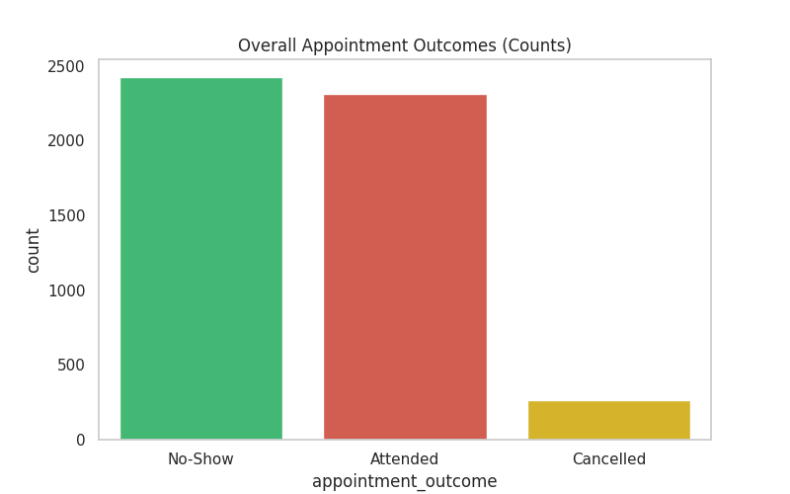
The Problem
Almost half of the appointment never happen
I looked at 5,000 appointments from HealthConnect Clinic dataset.
2,423 patients simply did not show up . That is 48.5%, almost half.
Only 263 cancelled properly. So the problem
is not people cancelling.
It is people forgetting, or not being able to
come.
Learn More

Slide 3
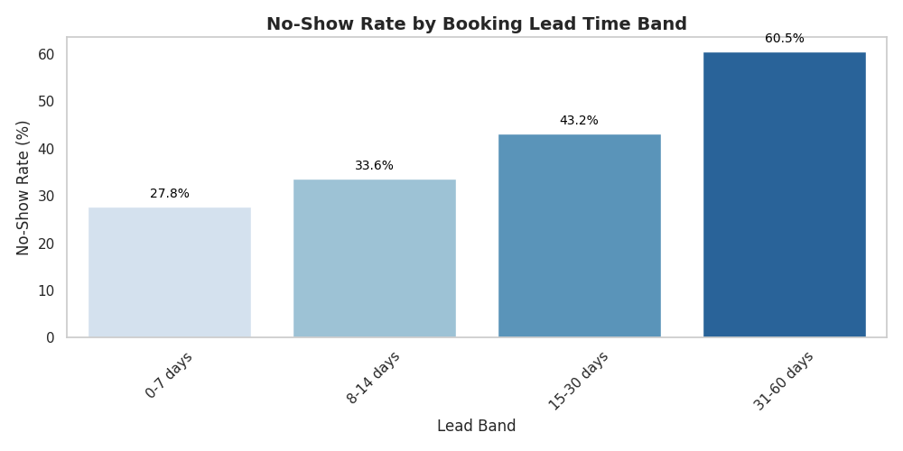
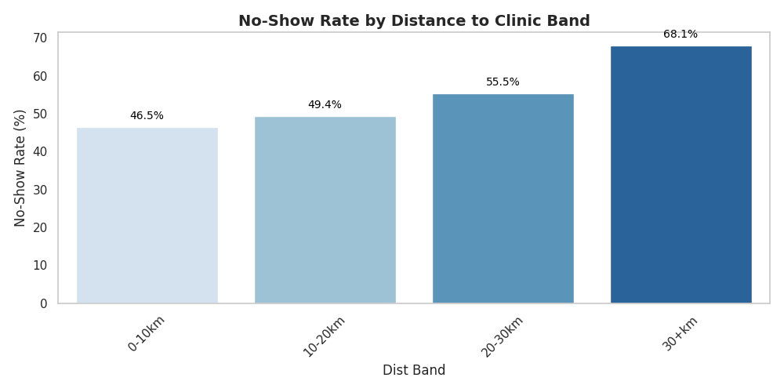
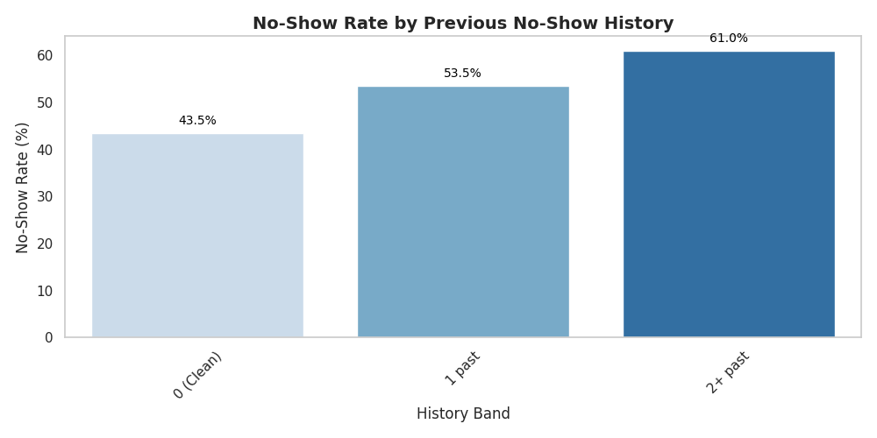
Larana, Inc.
Why People
Miss
  They book too early
  They live far
  They have missed
before

Slide 4
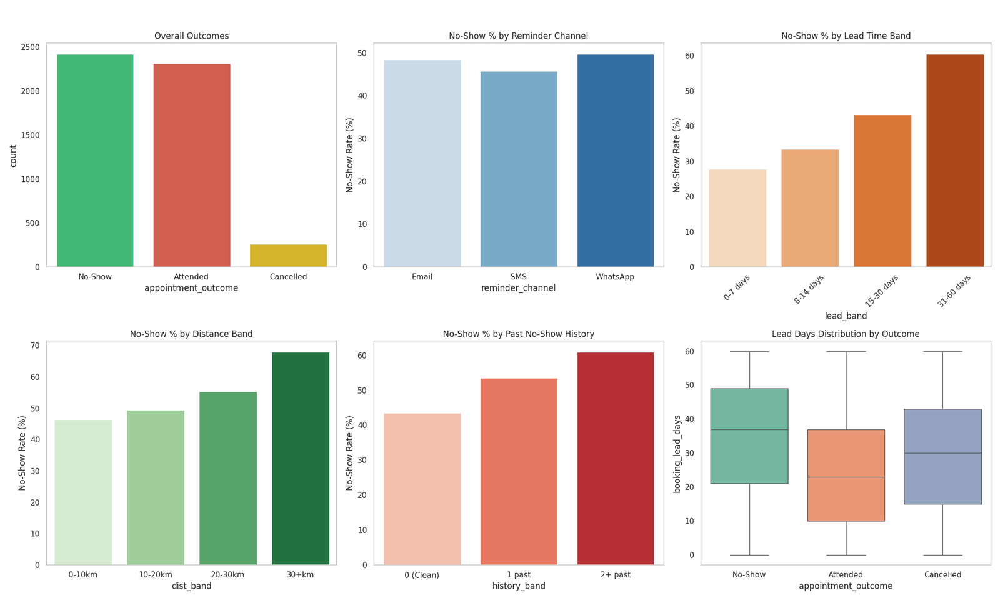
For early bookers
Ensure they send a Please Confirm text two weeks and 3 days before
For Missed Appointment Patients
Ensure they are called, not just text message
For Far away patients
Offer a video call meeting instead of constant visits to the clinic
What the
Clinic should do

Slide 5
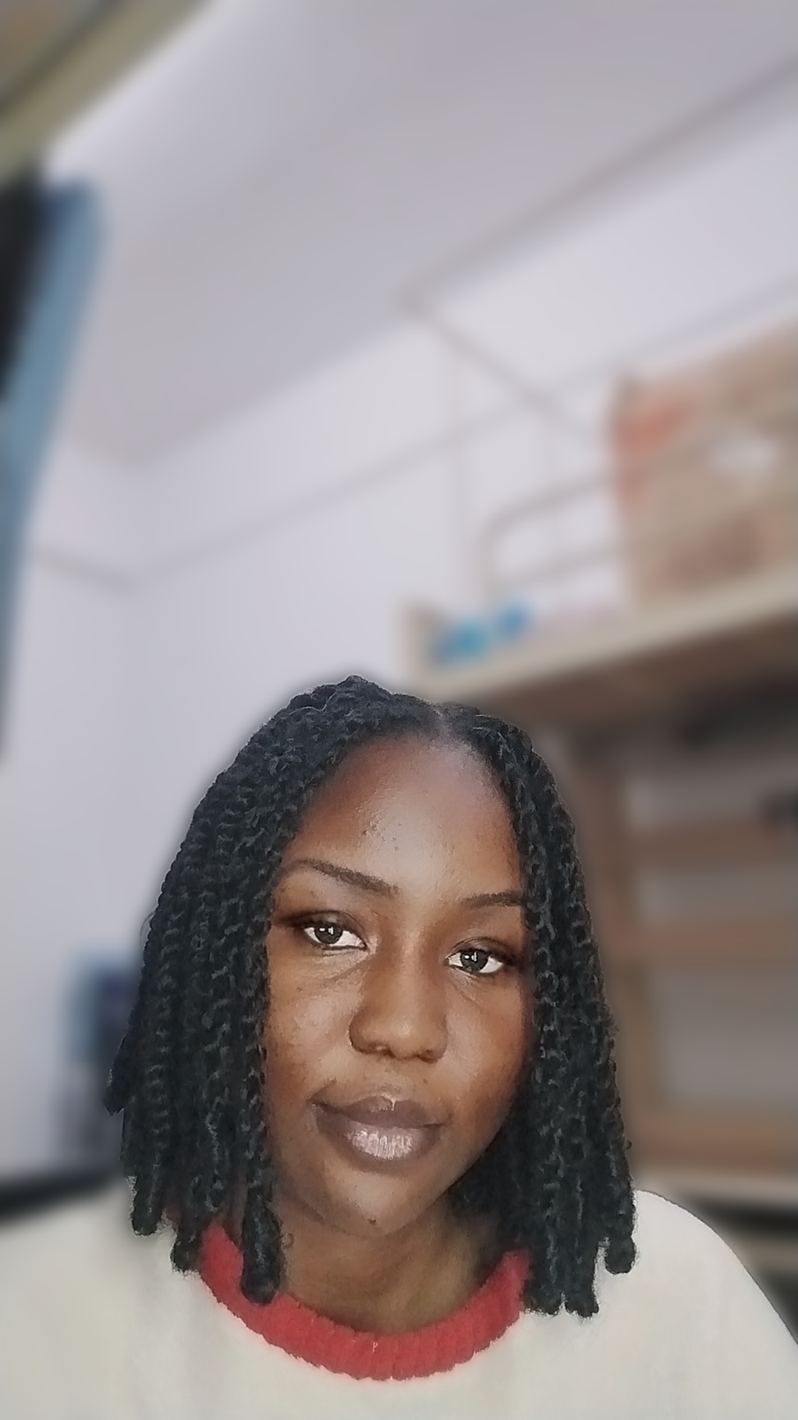
What this taught me
What this taught me
Data is only useful when it changes what people do.
My charts now feed a model that can flag risky appointments before they happen, and the clinic has three clear steps to try.
  Ojo Precious Mojolaoluwa
  Let’s connect

